Slide 1
Alco-Det - your safety our responsibility

Slide 2
Team Members
2110040006 – Sriya
2110040014 – Hemalatha
2110040020 – Sravani
2110040030 – Anusha
2110040039 - Roopa

Slide 3
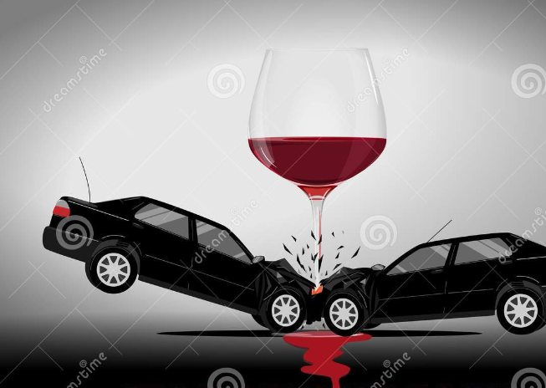
Vision and Mission
Driving under the influence of alcohol has affected and killed countless of people’s lives.
If you drink and drive, not only do you possibly put yourself at risk, but your passengers and pedestrians, and other people, who were on the roads.
Every thirty minutes someone’s life is at risk and families are devastated. So, we thought of Alcohol Detection system in order to control drunk and driving as much as we can.

Slide 4
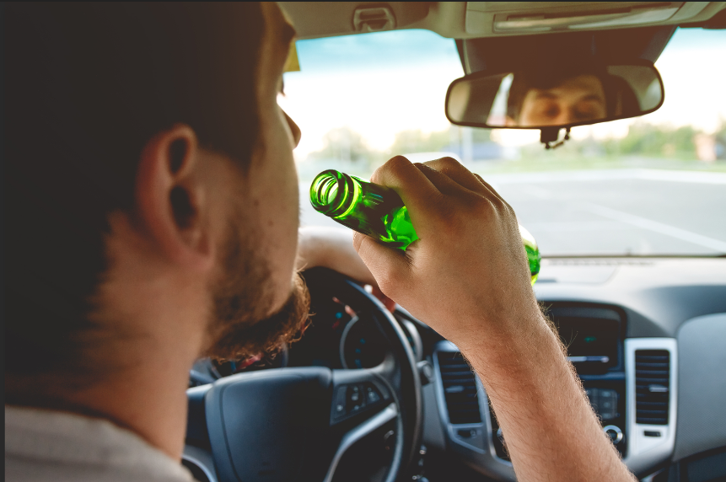
Problem Statement
The purpose of this project is to develop vehicle accident prevention by method of alcohol detector in an effort to reduce traffic cases based on driving under the influence of alcohol.

Slide 5
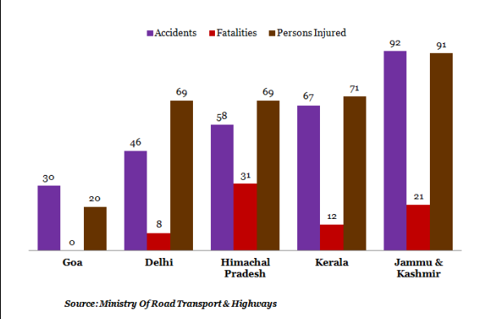
DRUNK AND DRIVE ACCIDENT CASES:

Slide 6
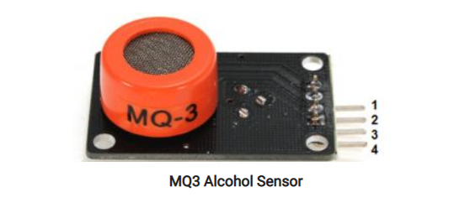
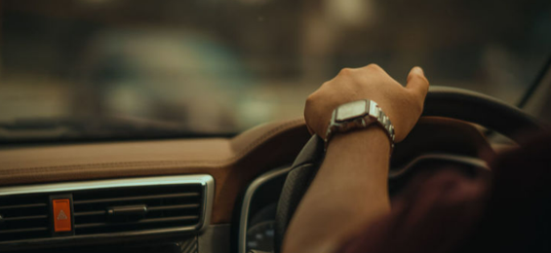
Proposed Solution
We use alcohol sensor(MQ3 sensor) to sense the ethanol content in air.
We integrate alcohol sensor with microcontroller.
If there is excess alcohol content in air the buzzer sounds continuously.

Slide 7
Image of Product/Service Flow Chart
POWER SUPPLY
LED DISPLAY
ESP
8266
MQ3 SENSOR
NOTOFICATION
DHT11
BUZZER

Slide 8
Investment Required
S.no | Component | Cost
1. | Alcohol sensor | 200
2. | ESP8266 | 300
3. | DHT11 | 150
4. | led | 20
5. | Buzzer | 50+

Slide 9
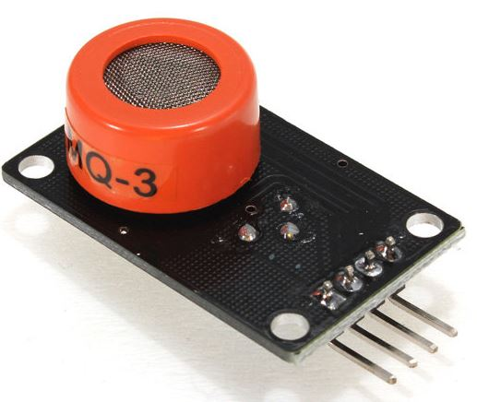
ALCOHOL SENSOR:
The alcohol sensor is technically referred to as a MQ3 sensor which detects ethanol in the air. When a drunk person breathes near the alcohol sensor it detects the ethanol in his breathe and provides an output based on alcohol concentration.

Slide 10
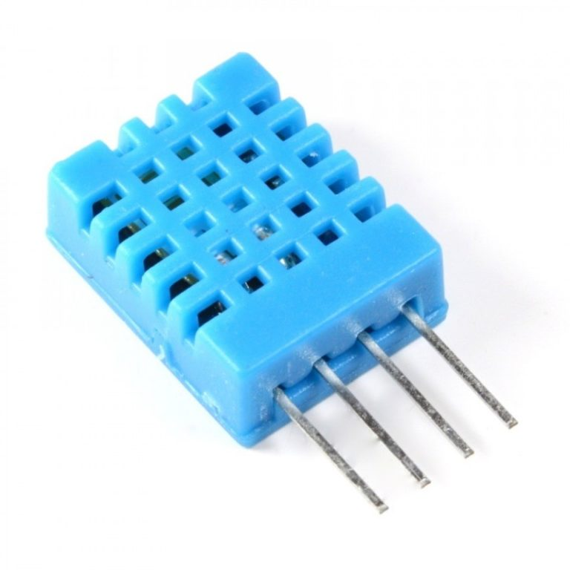
DHT11 SENSOR:
DHT11 is a digital temperature and humidity sensor that is commonly used in electronics projects. It is a low-cost sensor that can measure temperature between 0 to 50 degrees Celsius and humidity between 20% to 90% with an accuracy of +/- 2 degrees Celsius and +/- 5% humidity.

Slide 11
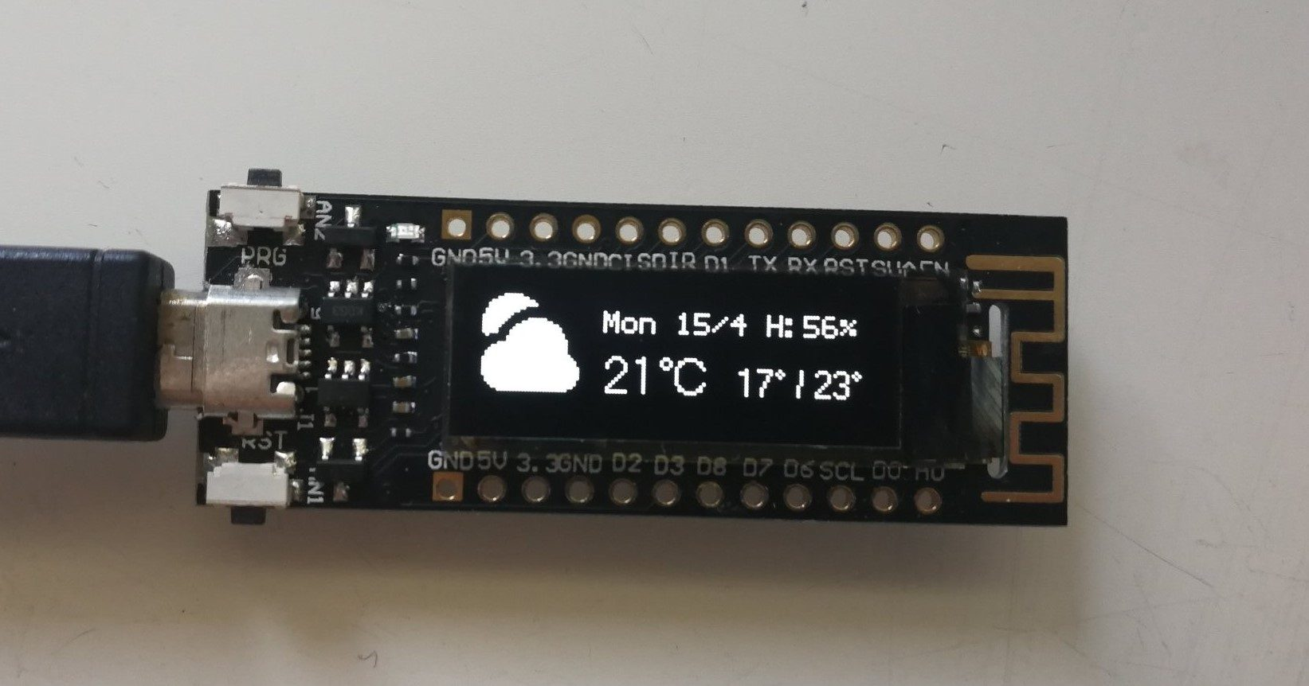
ESP8266:
ESP8266 is a low-cost Wi-Fi microchip that can be programmed to connect to a Wi-Fi network and communicate with other devices over the internet.
The ESP8266 can be programmed using the Arduino IDE or other programming languages like Lua, MicroPython, or C++.

Slide 12
 | Existing products | Competition products | New products
Features | Alcohol concentration check machine | Breath analyzer with lcd display | Auto car lock alco-det
Technology details incorporated to meet the functions | Ethenol level check when air is blown | Ethenol level check in air surrounded | Ethenol level check and control over the engine
Market and target customers | Police, government | Police, government, industries. | Car companies
Price(In comparison to the new and existing products) | around 1400 | breath analyzer | around 750

Slide 13
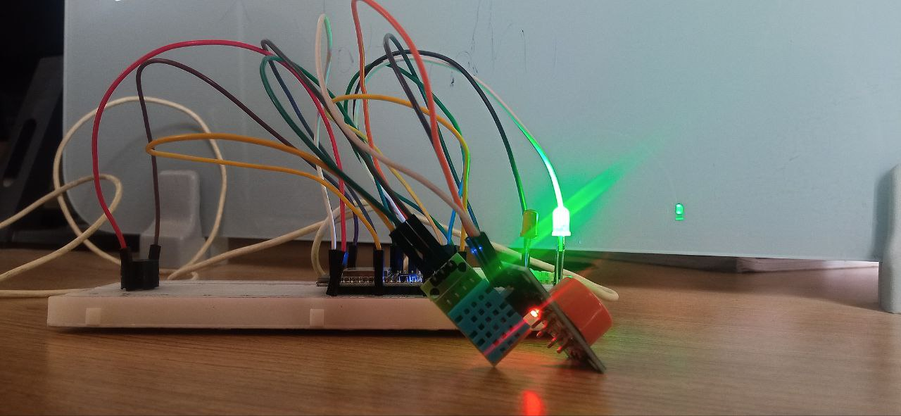
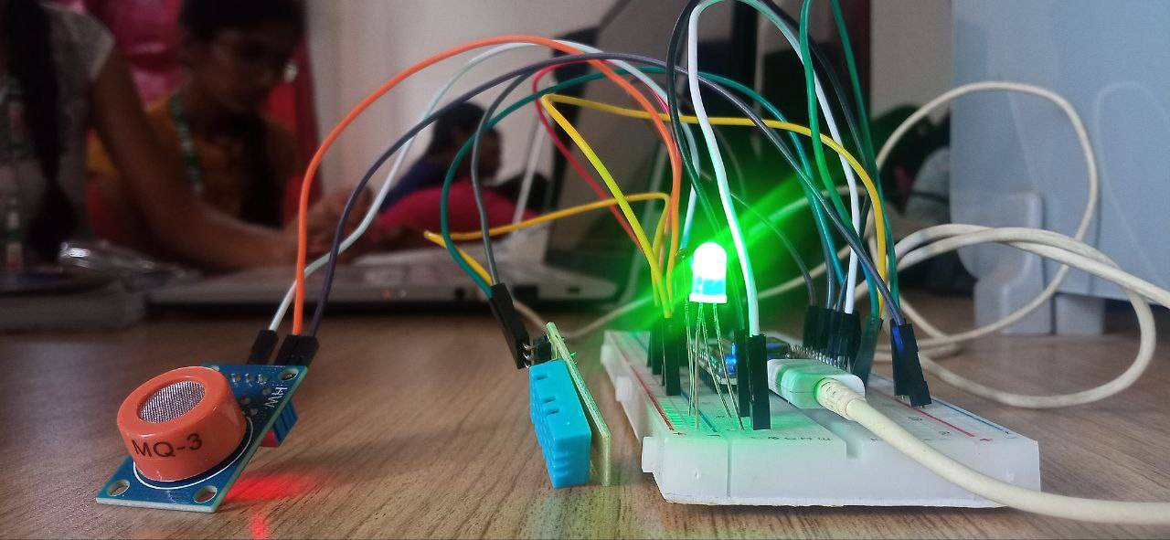
OUTPUT: (SAFE)

Slide 14
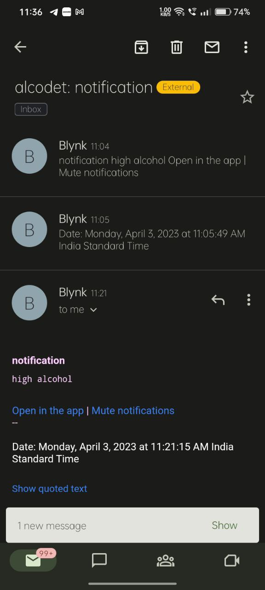
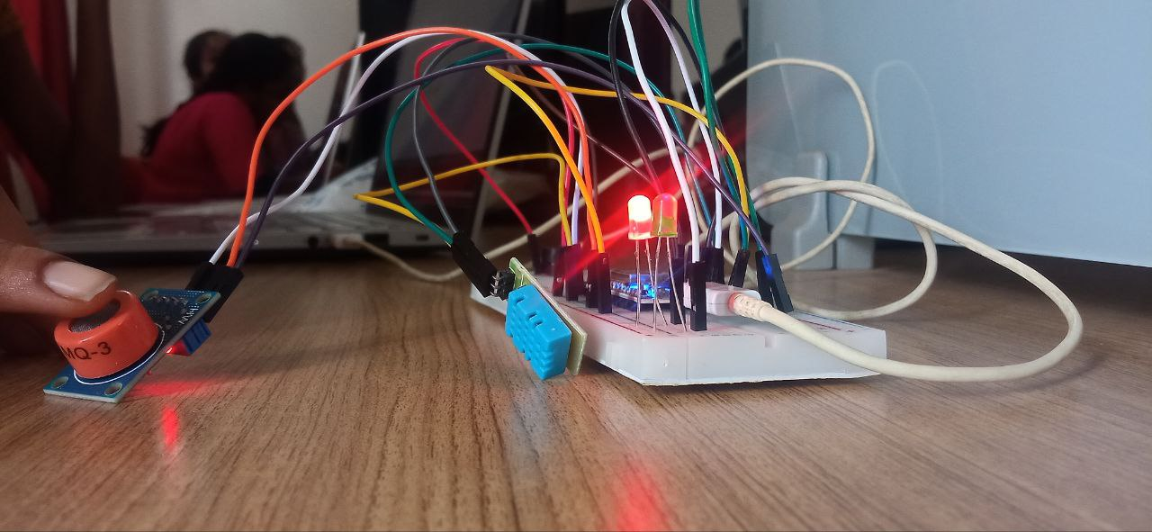
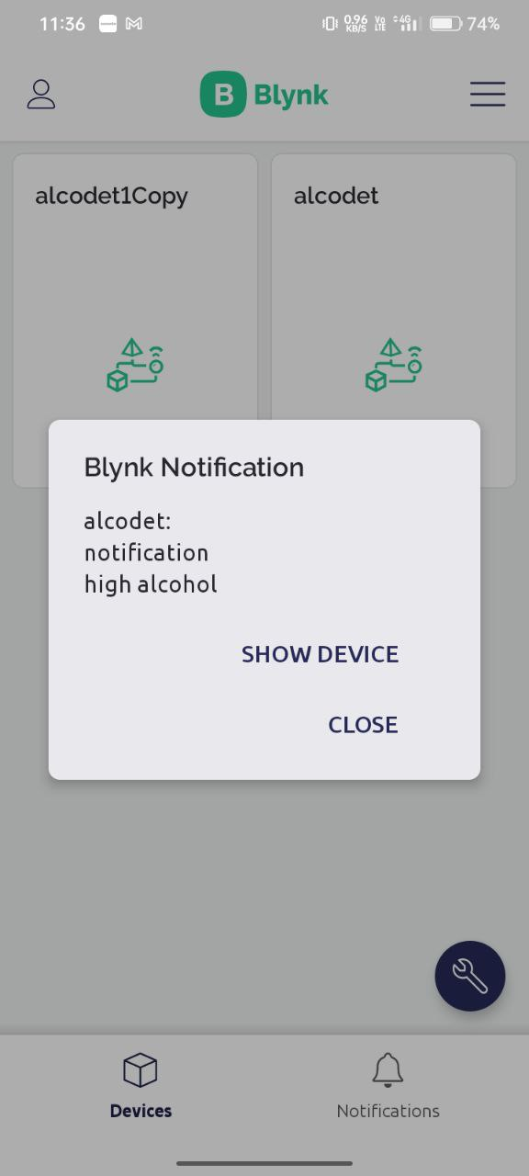
OUTPUT: (ALERT)

Slide 15
CONCLUSION:
In conclusion, alcohol detection plays a crucial role in ensuring public safety, particularly in situations such as driving, workplace safety, and law enforcement. The detection of alcohol in the body can be achieved through several methods, including breath tests, blood tests.
Overall, effective alcohol detection methods are essential for promoting responsible alcohol consumption and minimizing the risks associated with excessive alcohol consumption.
By using this prototype we can detect alcohol accurately and it is reliable because of the extra features like notifications.

Slide 16
THANK YOU

